Slide 1

AN OFFERING IN THE BLUE CYBER SERIES:
DOD Cybersecurity Incident Reporting
Version 24 June 2021
#2 in the Blue Cyber Education Series
Notes:
Presenter
2021-06-25 16:13:17
--------------------------------------------
Photo source Photo by: Air Force photo | VIRIN: 201002-F-ZX772-001.JPG https://www.afnwc.af.mil/News/Photos/igphoto/2002520957/

Slide 2
Federal Acquisition Regulation (FAR) and DFARS
Small Business contracts contains many FARS and DFARS, some are listed some are referenced and you have to look them up. These are not all, but some key security requirements.
What is a DFARS? The Defense Federal Acquisition Regulation Supplement (DFARS) contains requirements of law, DoD-wide policies, delegations of FAR authorities, deviations
from FAR requirements, and policies/procedures that have a significant effect on the public.
DFARS Clause 252.239-7010
Cloud Computing Services
FAR Clause 252.204-21
Basic Safeguarding of Covered Contractor Information Systems
DFARS Clause 252.204-7012,
Safeguarding Covered Defense Information and Cyber Incident Reporting
DFARS Clause 252.204-7008
Compliance with safeguarding covered defense information controls
DFARS Clause 252.204-7020
NIST SP 800-171
DoD Assessment Requirements.
DFARS Clause 252.204-7021
Cybersecurity Maturity Model Certification Requirement
2

Slide 3




DFARS Clause 252.204-7012,
Safeguarding Covered Defense Information and Cyber Incident Reporting
Report cyber incidents
Submit malicious software Facilitate damage assessment
Safeguard covered defense information
3
Notes:
Presenter
2021-06-25 16:13:17
--------------------------------------------
https://business.defense.gov/Portals/57/Safeguarding%20Covered%20Defense%20Information%20-%20The%20Basics.pdf Photo source https://www.afnwc.af.mil/News/Photos/igphoto/2002520957/

Slide 4
What if there is a potential breach?
Don’t panic. Cybersecurity occurs in a dynamic environment. Hackers are constantly coming up with new ways to attack information systems, and DoD is constantly responding to these threats. Even if a contractor does everything right and institutes the strongest checks and controls, it is possible that someone will come up with a new way to penetrate these measures. DoD does not penalize contractors acting in good faith. The key is to work in partnership with DoD so that new strategies can be developed to stay one step ahead of the hackers.
Contact DoD immediately. Bad news does not get any better with time. These attacks threaten America’s national security and put service members’ lives at risk. DoD has to respond quickly to change operational plans and to implement measures to respond to new threats and vulnerabilities. Contractors should report any potential breaches to DoD within 72 hours of discovery of any incident.
Be helpful and transparent. Contractors must also cooperate with DoD to respond to security incidents. Contractors should immediately preserve and protect all evidence and capture as much information about the incident as possible. They should review their networks to identify compromised computers, services, data and user accounts and identify specific covered defense information that may have been lost or compromised.
4
Notes:
Presenter
2021-06-25 16:13:18
--------------------------------------------
https://business.defense.gov/Small-Business/Cybersecurity/

Slide 5
What to Report to the Federal Government
DHS Definition: A cyber incident is an event that could jeopardize the confidentiality, integrity, or availability of digital information or information systems.
DFARS 7012 Definition “Cyber incident” means actions taken through the use of computer networks that result in a compromise or an actual or potentially adverse effect on an information system and/or the information residing therein.
Report all cyber incidents that may:
result in a significant loss of data, system availability, or control of systems;
impact a large number of victims;
indicate unauthorized access to, or malicious software present on, critical information technology systems;
affect critical infrastructure or core government functions; or
impact national security, economic security, or public health and safety.
5
Notes:
Presenter
2021-06-25 16:13:18
--------------------------------------------
From https://www.dhs.gov/sites/default/files/publications/Cyber%20Incident%20Reporting%20United%20Message.pdf

Slide 6


Where to report cyber incidents/malware
To report cyber incidents that affect covered defense information
Or that affect the contractor’s ability to perform requirements designated as operationally critical support, the Contractor shall conduct a review for evidence of compromise and rapidly report cyber incidents to DoD at https://dibnet.dod.mil/dibnet/ via an incident collection form (ICF).
If discovered and isolated in connection with a reported cyber incident, the contractor/ subcontractor shall submit the malicious software to the DoD Cyber Crime Center (DC3). Also, https://dibnet.dod.mil/dibnet/
If DoD elects to conduct a damage assessment, the Contracting Officer will be notified by the requiring activity to request media and damage assessment information from the contractor
6
Notes:
Presenter
2021-06-25 16:13:18
--------------------------------------------
“Malicious software” means computer software or firmware intended to perform an unauthorized process that will have adverse impact on the confidentiality, integrity, or availability of an information system. This definition includes a virus, worm, Trojan horse, or other code-based entity that infects a host, as well as spyware and some forms of adware. “Media” means physical devices or writing surfaces including, but is not limited to, magnetic tapes, optical disks, magnetic disks, large-scale integration memory chips, and printouts onto which covered defense information is recorded, stored, or printed within a covered contractor information system

Slide 7

Approved, DCN #0543-213-23
AN OFFERING IN THE BLUE CYBER SERIES
If you are a DOD contractor,
You must report cyber incidents to DC3
Notes:
Photo source Photo by: Air Force photo | VIRIN: 201002-F-ZX772-001.JPG https://www.afnwc.af.mil/News/Photos/igphoto/2002520957/

Slide 8
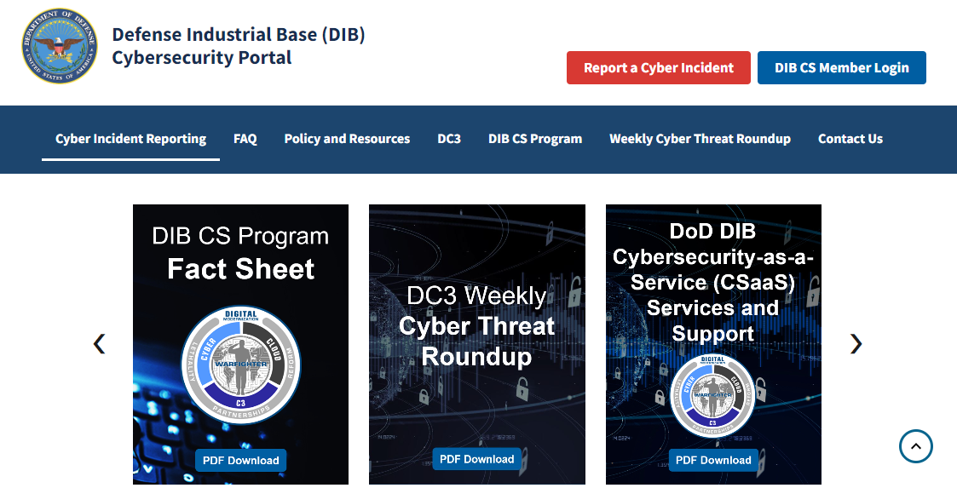
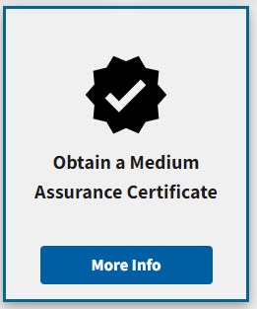
https://dibnet.dod.mil/dibnet/
https://
dibnet.dod.mil
DISTRIBUTION C. Distribution authorized to U.S. Government Agencies and their contractors
Notes:
Red Arrow – it will take 72 hours to get the Medium Assurance Certificate – go ahead
DOD DIB CS is for contractors working with Classified contracts. An unclassified contractor pilot is underway – more news in January 2022

Slide 9
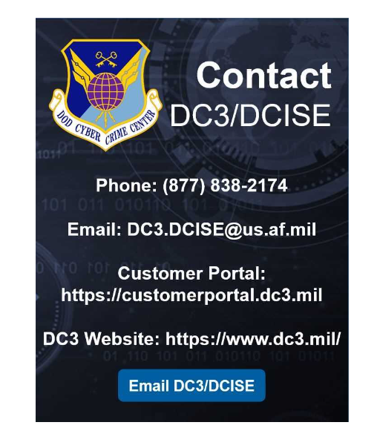
A DoD-Approved Medium Assurance Certificate is required to report a cyber incident via the portal.
If you do not have a DoD-approved Medium Assurance Certificate
please email DC3.DCISE@us.af.mil or
call the DoD-Defense Industrial Base Collaborative Information Sharing Environment (DCISE) hotline at (410) 981-0104 for further assistance.
This information repeats under the FAQs on the page
https://
dibnet.dod.mil
(410) 981-0104
IF YOU DO NOT HAVE A CAC
Notes:
Red Arrow – it will take 72 hours to get the Medium Assurance Certificate – go ahead
DOD DIB CS is for contractors working with Classified contracts. An unclassified contractor pilot is underway – more news in January 2022

Slide 10
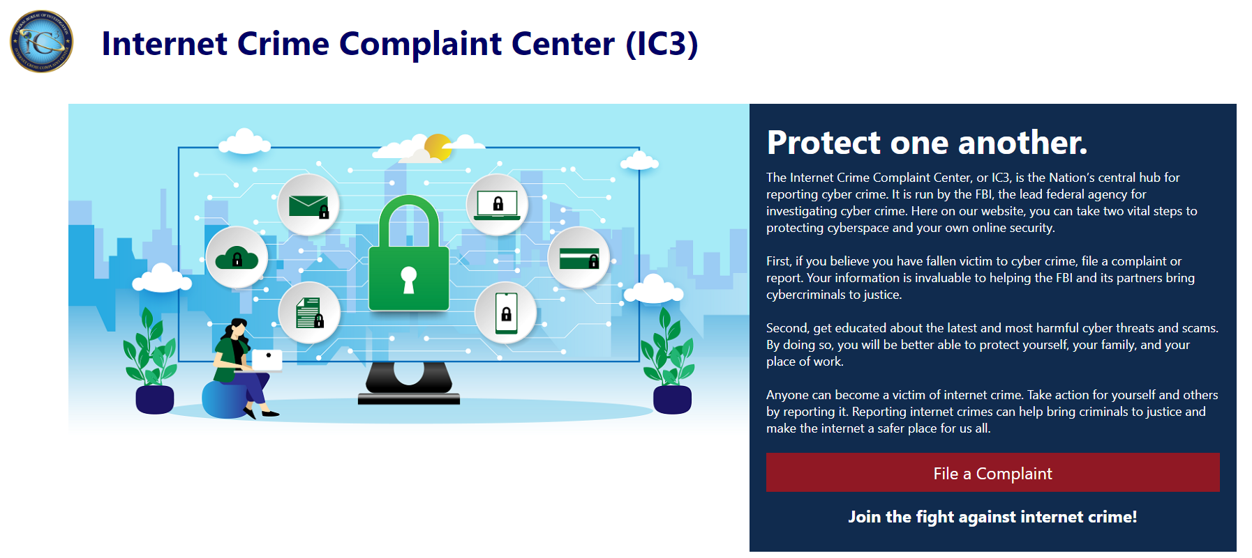
www.ic3.gov
The mission of the Internet Crime Complaint Center is to provide the public with a reliable and convenient reporting mechanism to submit information to the Federal Bureau of Investigation concerning suspected Internet-facilitated criminal activity and to develop effective alliances with law enforcement and industry ..
https://
dibnet.dod.mil
DISTRIBUTION C. Distribution authorized to U.S. Government Agencies and their contractors
Notes:
Red Arrow – it will take 72 hours to get the Medium Assurance Certificate – go ahead
DOD DIB CS is for contractors working with Classified contracts. An unclassified contractor pilot is underway – more news in January 2022

Slide 11
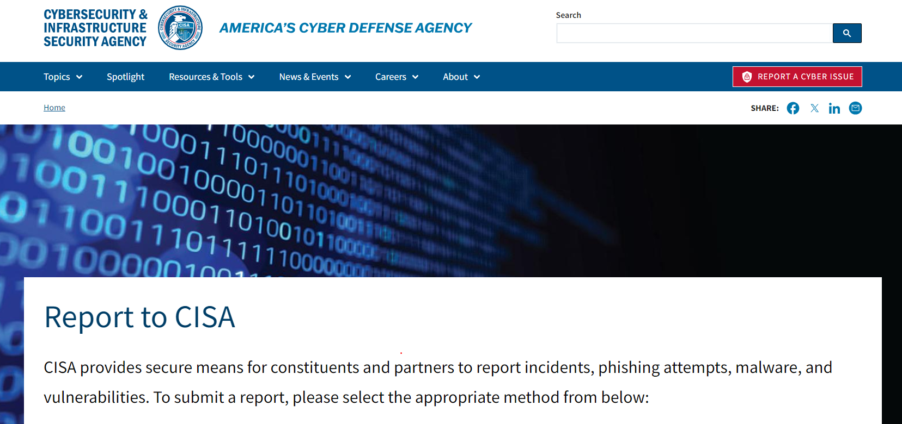
www.cisa.gov/report
The mission of the Internet Crime Complaint Center is to provide the public with a reliable and convenient reporting mechanism to submit information to the Federal Bureau of Investigation concerning suspected Internet-facilitated criminal activity and to develop effective alliances with law enforcement and industry ..
https://
dibnet.dod.mil
DISTRIBUTION C. Distribution authorized to U.S. Government Agencies and their contractors
Notes:
Red Arrow – it will take 72 hours to get the Medium Assurance Certificate – go ahead
DOD DIB CS is for contractors working with Classified contracts. An unclassified contractor pilot is underway – more news in January 2022

Slide 12
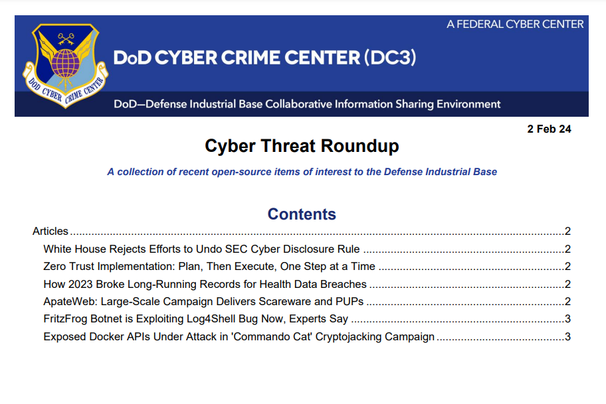
Notes:
Presenter
2021-06-25 16:13:19
--------------------------------------------
https://dibnet.dod.mil/portal/rest/jcr/repository/collaboration/sites/intranet/web%20contents/site%20artifacts/public-content/Cyber%20Threat%20Roundup.pdf

Slide 13
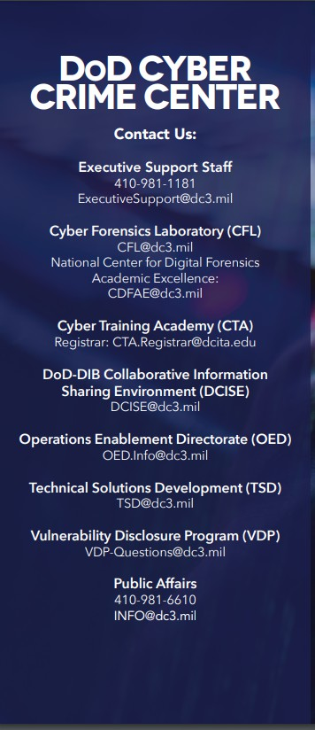
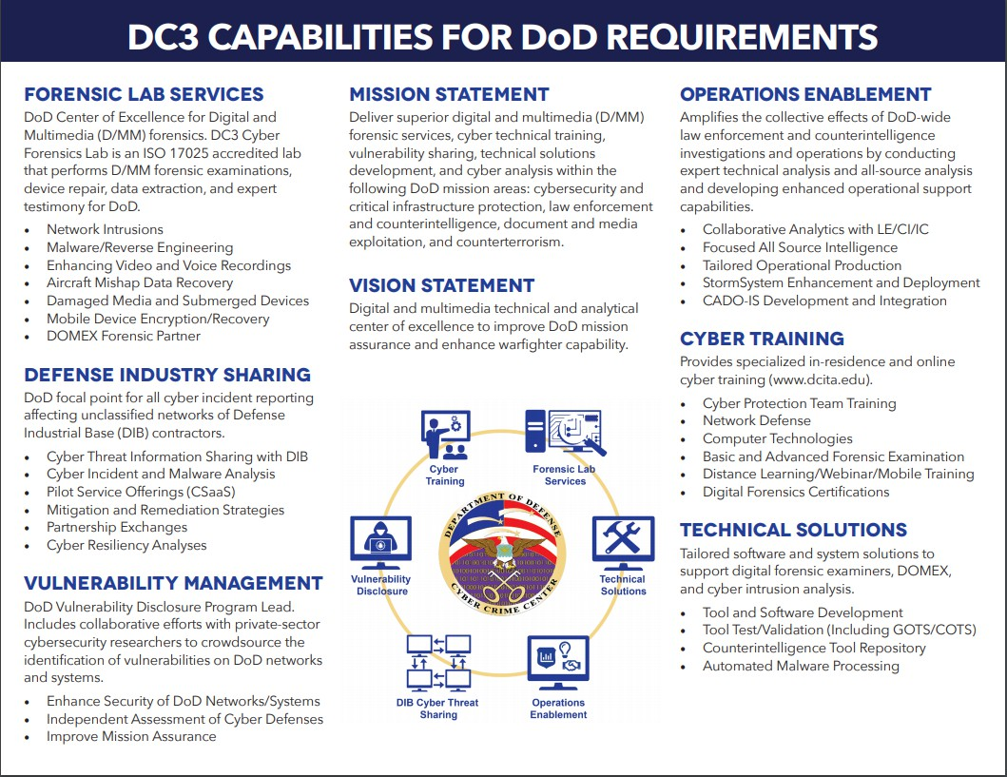
Notes:
Presenter
2021-06-25 16:13:19
--------------------------------------------
https://www.dc3.mil/Portals/100/Documents/DC3/Resources/Trifolds/DC3-Trifold-Final_26Apr21.pdf?ver=rt-N9XYyQMNv4lagCc-4rQ%3d%3d

Slide 14
Any Questions?
This briefing is not a substitute for reading the FARS/DFARS
Resources and more modules like this are coming every day!
Please provide questions, feedback or if you just want to talk about your cyber security /data protection questions at https://www.safcn.af.mil/Contact-Us/
12

